Slide 1
CLOUDBRUST PREDICTION SYSTEM
CSE7101- Capstone Project
Review-3
Batch Number: CSE_213
Under the Supervision of,
Mr.Jerrin Joe Francis
Assistant Professor
School of Computer Science and Engineering
Presidency University
Roll Number | Student Name
20221CSE0149 | Vandana.G
Name of the Program: B.Tech CSE
Name of the HoD: Dr. Asif Mohammed
Name of the Program Project Coordinator: Dr. Jayavadivel Ravi
Name of the School Project Coordinators: Dr. Sampath A K , Dr. Geetha A

Slide 2
Problem Statement Number: PSCS_61
Organization: Presidency University
Category (Hardware / Software / Both) : Software
Problem Description:
Cloudbursts are sudden, extreme rainfall events often leading to flash floods and catastrophic damage. They are difficult to predict due to their localized and rapid onset nature. Currently, most rainfall prediction models lack the resolution and real-time analysis needed to accurately forecast cloudbursts, leading to unpreparedness in vulnerable regions.

Slide 3
Abstract
Cloudbursts are sudden, intense rainfall events that can lead to devastating flash floods, especially in mountainous and urban regions. Early detection and timely alerts are crucial to mitigate their impact. This project presents a Cloudburst Prediction System developed using JavaScript and ReactJS, designed to provide real-time weather monitoring and alert generation through a web-based interface.
The system architecture comprises a ReactJS-based user interface for data input and alert visualization, and a JavaScript-powered backend API that fetches real-time weather data from external sources . The backend processes this data using a rule-based Alert Rules Engine, which evaluates predefined thresholds for parameters like rainfall intensity, humidity, and atmospheric pressure. When conditions indicate a potential cloudburst, the system triggers alerts via a Notification Module, which supports both on-screen and email/SMS notifications.
This project demonstrates how modern web technologies can be effectively leveraged to build a responsive and reliable early warning system for natural disasters, without relying on complex machine learning models.

Slide 4
Literature Survey
Statistical Models (ARIMA, regression, time series): Simple but fail with non-linear chaotic rainfall patterns [9].
Machine Learning (RF, SVM, Ensembles): Improved accuracy but lacked real-time alerts & deployment [1–4,8].
Deep Learning (LSTM, CNN, CNN-LSTM): Captures temporal & spatial patterns well, but needs big data + high computation [2,6,7].
Domain-specific / GIS / Cloud computing models: Accurate but region-limited or costly [5,9,10].
Rule-based Systems: Fast, interpretable, good for real-time responsiveness [4].
Web/API-based Systems: Enable user-friendly, cross-platform apps [1,3,8].
Our Project: Combines real-time APIs + Java-based lightweight design + rule-based predictions + visualization & alerts, making it practical, cost-effective, and deployable.

Slide 5
Literature Survey
No. | Title & Authors | Technique(s) | Missing Area in Their Work | Advantage of Our Project
1 | Stormsense: A Multi-Model Cloudburst Prediction System (Various, 2025) | RF, SVM, CNN (VGG16) + API alerts | Lacks user-friendly desktop app and visualization; mostly model accuracy | Our JavaFX UI + JFreeChart makes predictions easy to monitor in real time
2 | District-Level Rainfall & Cloudburst Prediction (Raghuwanshi et al., 2025) | XGBoost vs LSTM/RF | Focuses on accuracy only; no alert mechanism or operational system | Our project provides alerts (SMS/Email) + visualization for direct usability
3 | Cloudburst Prediction in India Using ML (Teja et al., 2024) | KNN on meteorological features | Limited to classification; no real-time API integration | Ours works live with API data and can extend to ML later
4 | Cloudburst Prediction System Using ML (Raghavendra T.S. et al., 2024) | Binary classification | No emphasis on UI/visuals, rule-based interpretability missing | Our hybrid approach (rule + ML) is transparent & user-friendly
5 | Cloudburst Forecasting System (AI + GIS) (Sharma et al., 2025) | AI + GIS | Heavy focus on GIS; no lightweight implementation for local systems | Our project is lightweight & cost-effective with Java APIs
6 | LSTM Weather Forecasting in Central Java (Susanto et al., 2023) | LSTM neural networks | Limited to one region (Central Java); lacks alerting system | Ours is generalizable to multiple regions with configurable inputs
7 | Rainfall Classification of Java Island (ANN + Kriging) (Santoso et al., 2022) | ANN + Kriging interpolation | Only classification maps; no real-time monitoring | Our system provides continuous monitoring + live trends
8 | Weather Prediction Using ML Classifiers (Singh et al., 2024) | XGBoost, RF, GB | Accuracy study only; no practical deployment | Our project bridges accuracy + usability with live UI
9 | Weather Forecasting with Cloud Computing & Data Mining (Ali et al., 2018) | Data mining + cloud | Needs high infra (cloud setup); not practical for small setups | Our Java app runs on standard PC, low-cost deployment
10 | Maritime Weather Prediction Using Fuzzy Logic (Irawan et al., 2019) | Fuzzy Logic, ARIMA | Domain-specific (maritime); lacks general weather/alerts | Our system is versatile, not tied to one domain

Slide 6
Objectives
To develop a predictive model for detecting potential cloudburst events in real time.
To use meteorological, atmospheric, and historical rainfall data for accurate predictions.
To provide early warnings to minimize loss of life and property.
To visualize prediction results for better interpretability by disaster management authorities.

Slide 7
Existing Methods and Drawbacks
Cloudbursts are sudden, intense rainfall events that can cause flash floods and significant damage in a short span of time. Traditional meteorological prediction methods often fail to detect such events early due to the highly localized and rapid nature of cloudbursts.
Existing works in weather monitoring have used such APIs to build real-time dashboards for disaster preparedness. However, most focus on general rainfall forecasting rather than specialized cloudburst detection with automated alert systems.Our project bridges this gap by fetching real-time weather data, applying threshold-based logic for cloudburst conditions, and triggering alerts.

Slide 8
Github Link
Github Link
https://github.com/gannevandana/CloudBrust-Prediction-System

Slide 9
Algorithm Details
To predict the risk level of a cloudburst (High, Moderate, Low) by analyzing weather data using logical if-else rules and algorithms.
Inputs (Weather Parameters):
Rainfall (in mm/hour)
Humidity (in %)
WindPressure (in hPa)
(Optional) windSpeed (in km/h)
Outputs:
"High Risk" – Conditions strongly indicate a possible cloudburst
"Moderate Risk" – Conditions are concerning, but not extreme
"Low Risk" – Safe or normal weather conditions

Slide 10
Pseudo Code
function predictCloudburstRisk(weatherData):
rainfall = weatherData.rainfall // mm/hr
humidity = weatherData.humidity // %
cloudCover = weatherData.cloudCover // %
windSpeed = weatherData.windSpeed // km/h (optional)
pressure = weatherData.pressure // hPa (optional)
if rainfall > 100:
return "High Risk"
else if humidity > 90 AND cloudCover > 80:
return "Moderate Risk"
else if windSpeed > 50 AND pressure < 1000:
return "Moderate Risk"
else:
return "Low Risk"

Slide 11
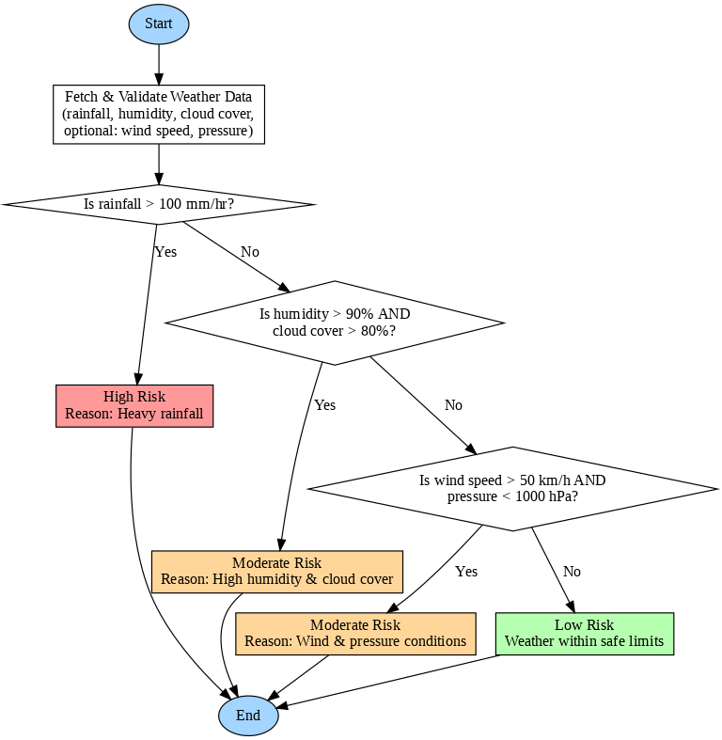
Flow Chart

Slide 12
Proposed method and feasibility study
Proposed Methodology
Data Acquisition – Collect real-time & historical weather data (temperature, humidity, rainfall, wind, pressure) using APIs like WeatherAPI/OpenWeatherMap.
Data Processing – Preprocess and filter data in Java; handle missing/erroneous values.
Prediction Model – Apply rule-based thresholds (e.g., humidity + rainfall + pressure drop) to identify potential cloudburst; future scope to integrate ML (e.g., Random Forest/LSTM).
Visualization & Alerts – Display weather trends via JavaFX/JFreeChart UI, and trigger alerts (email/SMS) when thresholds are exceeded.
Validation – Compare predictions with historical events to measure accuracy and improve rules.

Slide 13
Proposed method and feasibility study
Feasibility Study
Technical Feasibility – Implemented using Java (cross-platform), APIs, JavaFX; minimal hardware; optional ML integration possible.
Operational Feasibility – User-friendly UI, real-time monitoring, useful for authorities, disaster management, and researchers.
Economic Feasibility – Low-cost (free APIs, open-source tools), no need for expensive infrastructure.
Schedule Feasibility – Core system (API integration, rule-based prediction, UI) achievable in project timeline; advanced ML can be added later as extension.

Slide 14
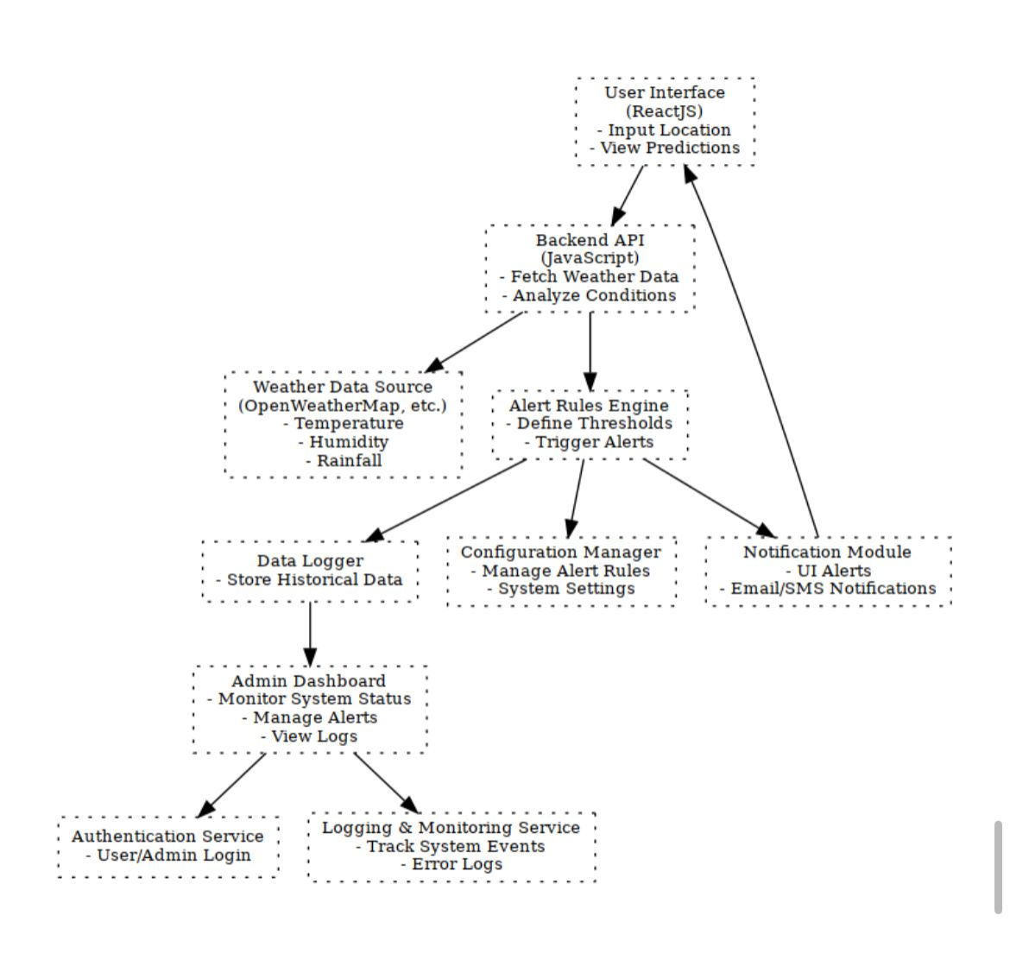
Architecture

Slide 15
Modules
1.User Interface (ReactJS)
Built using ReactJS, this module provides a dynamic and responsive front-end.
Users can input their location to receive predictions.
It fetches data from the backend and displays alerts, weather conditions, and system status.
Admins can log in to access dashboards and manage configurations.
2. Backend API (JavaScript)
Acts as the central processing unit of the system.
Receives requests from the UI and routes them to appropriate services.
Fetches weather data from external APIs and forwards it to the Alert Rules Engine.
Handles authentication, logging, and configuration updates.
3. Weather Data Source
Connects to third-party APIs like OpenWeatherMap.
Retrieves real-time weather metrics such as rainfall intensity, humidity, temperature, and pressure.
Sends this data to the backend for further processing.

Slide 16
Modules
4. Alert Rules Engine
Evaluates incoming weather data against predefined thresholds.
Uses logical conditions (e.g., rainfall > 100mm/hr) to detect cloudburst risks.
If conditions are met, it triggers alerts and logs the event.
Can be updated dynamically via the Configuration Manager.
5. Notification Module
Receives alert triggers from the Alert Rules Engine.
Sends notifications to users via:
• On-screen alerts in the UI
• Email and SMS messages
Ensures alerts are delivered promptly and reliably.
6.Data Logger
Records all weather data and alert events.
Stores information in a structured format for future analysis.
Supports audit trails and historical trend evaluation.

Slide 17
Modules
7. Admin Dashboard
Provides a secure interface for system administrators.
Displays system status, active alerts, and historical logs.
Allows admins to manage alert rules, user access, and configurations.
8. Authentication Service
Manages login and access control for users and admins.
Verifies credentials and maintains session security.
Ensures only authorized users can access sensitive features.
9. Logging & Monitoring Service
Tracks system performance, errors, and operational events.
Logs backend activity and monitors service health.
Provides insights for debugging and system optimization.

Slide 18
Hardware & Software
Hardware Requirements Minimum (for development/testing)
Processor: Intel i3 (10th Gen) / AMD Ryzen 3 or equivalent
RAM: 4 GB
Storage: 20 GB free space
Network: Stable broadband internet (≥ 10 Mbps)
Device: Standard PC / Laptop with browser support
Software Requirements Frontend (User Side)
Framework: ReactJS
Languages: JavaScript, HTML5, CSS3
Visualization: Chart.js
Browser Compatibility: Chrome, Firefox, Edge, SafariBackend (Server Side)
Runtime Environment: Node.js (v16 or above)
Framework: Express.js (for API handling)
Data Handling: REST APIs / WebSockets for real-time updates
Notification Service: Twilio / Firebase Cloud Messaging / SMTP for alertsDatabase
Cloud DB: Firebase / MongoDB Atlas

Slide 19
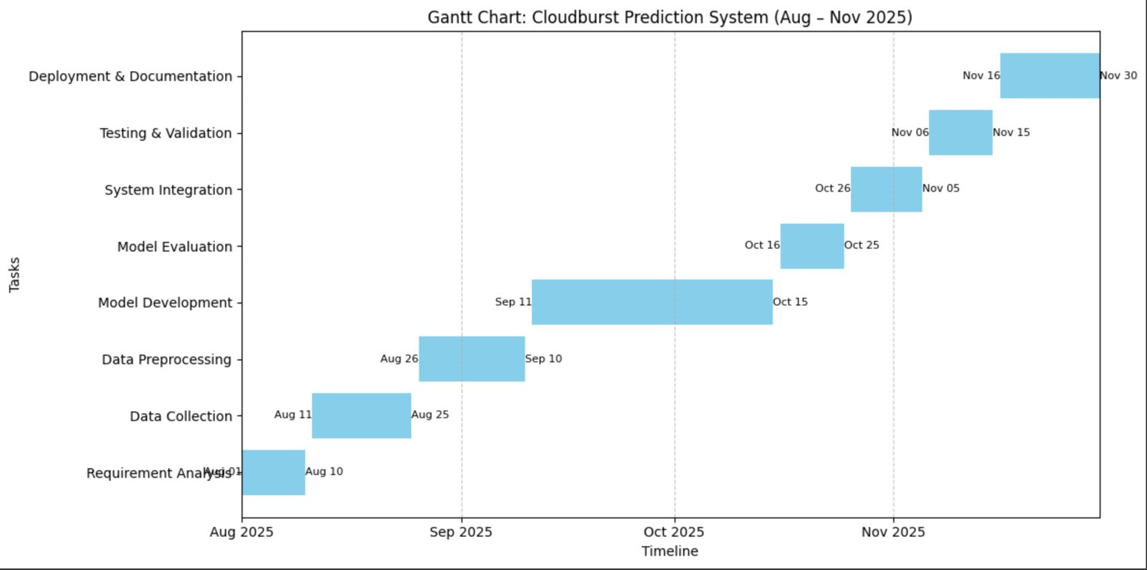
Timeline of the Project (Gantt Chart)

Slide 20
References (IEEE Paper format)
Stormsense: A Multi-Model Cloudburst Prediction System Using ML and Deep Image Processing (2025)
Combines Random Forest, SVM, and CNN (VGG16) on satellite images for cloudburst prediction. Real-time alerts via Pushbullet API. theaspd.com
District-Level Rainfall and Cloudburst Prediction Using XGBoost (2025)
Uses XGBoost for forecasting cloudbursts using historical rainfall data; outperforms LSTM and Random Forest. dspace.iiti.ac.ininformatica.si
Cloudburst Prediction in India Using Machine Learning (2024)
Employs K-Nearest Neighbors on features like humidity, wind, pressure for predicting cloudbursts in Indian regions. philarchive.orgPhilPapers
Cloudburst Prediction System Using Machine Learning (2024)
Implements a binary classification model to forecast real-time cloudburst events across India. IJRASET
Cloudburst Forecasting System (AI-based, with GIS) (2025)
AI-driven system processing weather reports and satellite/radar data, with GIS support to aid resource allocation. IJRASET
Implementation of LSTM to Predict Weather in Central Java (2023)
Uses LSTM neural networks to forecast temperature, rainfall, and humidity in Central Java. jutif.if.unsoed.ac.id
Prediction of Rainfall Classification of Java Island with ANN + Kriging (2022)
Combines artificial neural networks with spatial interpolation (Kriging) to generate rainfall classification maps. ejurnal.stmik-budidarma.ac.id
Weather Prediction Using Machine Learning Classifiers (2024)
Compares XGBoost, Gradient Boosting, and Random Forest for weather prediction; XGBoost achieves ~82% accuracy. jicet.org
Design & Implementation of Weather Forecasting System Based on Cloud Computing & Data Mining (2018)
Cloud-based weather forecasting using data mining techniques to analyze atmospheric conditions. sciencepubco.com
Maritime Weather Prediction Using Fuzzy Logic in Java Sea
Applies fuzzy logic, ARIMA, and other statistical methods for maritime weather forecasting (Java Sea context). scholar.its.ac.id

Slide 21


